Slide 1



Clément Letizia

Slide 2
TABLE OF CONTENTS
Presentation
The basics of an API
Interactions in an architecture
Authentication

Slide 3





Who I am ?
MISSION

Slide 4
The basis of APIs

Slide 5
The basis of APIs
“Different standards”
SOAP
(g)RPC
REST
GraphQL

Slide 6
The basis of APIs
“SOAP: Simple Object Access Protocol”
SOAP
Envelope : Defining the structure of the message
Encoding : Rules for expressing the type of data
Requests : How each SOAP API request is structured
Responses : How each SOAP API response is structured
Function-oriented
XML
WSDL (Web Service Description Language)
A WSDL document describes a web service. It specifies the location of the service, and the methods of the service.

Slide 7
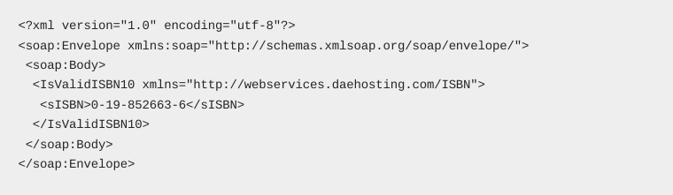
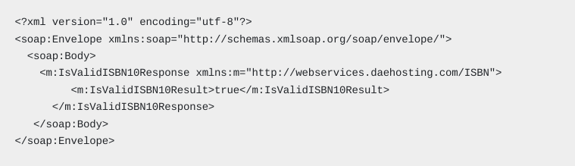
The basis of APIs
“What's does it look like”
SOAP
Request :
Function-oriented
XML
WSDL
Response :
https://webservices.daehosting.com/services/isbnservice.wso?WSDL

Slide 8
The basis of APIs
“Benefits”
SOAP
Portability : Language, transport, and event platform independent.
Very secure : Perfect for systems that handle sensitive data, such as financial services and online banking applications.
Works well in distributed environments
Built-in error handling features : easier to understand what happened when a request fails.
Function-oriented
XML
WSDL

Slide 9
The basis of APIs
“Disadvantages”
SOAP
Does not support caching API calls.
Accessibility : Pretty complicated to build a SOAP API
Adaptability
Usually not fast
Function-oriented
XML
WSDL

Slide 10
The basis of APIs
“Use cases”
SOAP
Transfers at banks : Bank transfers require communication between different banks or bank branches, which may involve multiple calls to different web services. Security is also extremely important for this use case.
Booking flights : Different web services must be called to check availability and flight pricing information.
Billing services : People who work in fields like telecommunication operations need to connect with numerous systems to generate billing information, which often includes sensitive data.
Navigation companies : Shipping and transport companies need to combine information from lots of different sources to calculate the best routes possible.
City management : SOAP APIs connect many city management processes to ensure the city is run properly. All of these processes— from traffic light management to sewage system operations—need to work in a predictable way.
Function-oriented
XML
WSDL

Slide 11
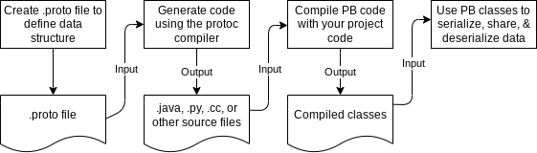
The basis of APIs
“gRPC: Google Remote Procedure Call”
gRPC
Protocol Buffers : are language-neutral, platform-neutral exstansible for serializing structured data
Cross- language : C++, C#, Jave, Kotlin, Objective-C, PHP, Python, Ruby, Dart (plugin), Go (plugin)
Function-oriented
Protobuf
HTTP/2 streams

Slide 12
The basis of APIs
“Interaction types”
gRPC
Client -> Request
Server -> Response
Unary RPC
Function-oriented
Protobuf
HTTP/2 streams
Server Streaming RPC
Client -> Request
Server -> Stream
Client Streaming RPC
Client -> Stream
Server -> Response
Bidirectional Streaming RPC
Client -> Stream
Server -> Stream

Slide 13
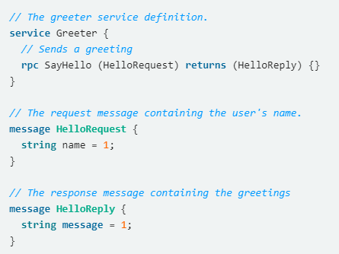
The basis of APIs
“gRPC: Google Remote Procedure Call”
gRPC
Function-oriented
Protobuf
HTTP/2 streams

Slide 14
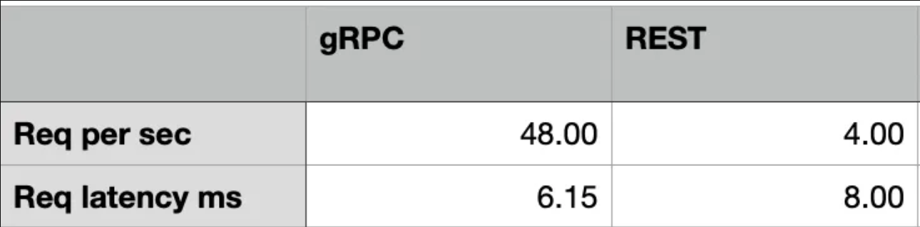
The basis of APIs
“gRPC: Google Remote Procedure Call”
gRPC
Function-oriented
Protobuf
HTTP/2 streams
Source : https://medium.com/analytics-vidhya/grpc-vs-rest-performance-comparison-1fe5fb14a01c

Slide 15
The basis of APIs
“RESTFul Principles”
REST
Layered System
Composed of hierarchical layers by constraining component behavior
A design pattern that enforces the separation of concerns
Client-server
Resources-oriented
CRUD
RESTful Principles
Each request must contain all information mandated to be executed
Stateless
A response should implicitly or explicitly label itself as cacheable or not
Cacheable
Uniform Interface
?

Slide 16
The basis of APIs
“A principle that encompasses four aspects”
REST
Identifying resources
Individual resources are identified in requests
Holds a representation of a resource with enough information to modify or delete resource
Resources-oriented
CRUD
RESTful Principles
Resource handling
Each message includes enough information to describe how to process the message
Self-describing message
Clients make state transition only through actions that are dynamically identified within hypermedia by the server
Hypermedia

Slide 17
The basis of APIs
“REST: Basic verbs”
REST
GET
Obtain a resource
Resources-oriented
CRUD
RESTful Principles
POST
Create a resource
PUT
Modify a resource entirely
DELETE
Remove a resource
PATCH
Partially modify a resource

Slide 18
The basis of APIs
“HTTP response codes”
REST
1XX
Informational responses
Resources-oriented
CRUD
RESTful Principles
2XX
Successful responses
3XX
Redirection messages
4XX
Client error responses
5XX
Server error responses

Slide 19
The basis of APIs
“What are the HTTP verbs for these routes?”
Sensor REST API
Partially modify a sensor
Retrieve the list of sensors
Add a sensor
Search for a sensor by ID
Modify a sensor completely
Delete a sensor

Slide 20



The basis of APIs
“Several endpoints, one solution”
Service 1
I would like information on service 1, 2 and 3
Service 2
Client
GraphQL endpoint
Service 3

Slide 21
The basis of APIs
“One endpoint to rule them all”
GraphQL
Accuracy of information : Fetch the exact data needed.
Single endpoint : Call a unique enpoint to acccess all the resources
Mutation : Are used to add or modify data
Strongly typed schema : helps developers understand the relationship between data elements and fine-tune the query structure
Resources-oriented
GraphQL query
HTTP / HTTPS

Slide 22
The basis of APIs
“Benefits”
GraphQL
DEMO
Resources-oriented
GraphQL query
HTTP / HTTPS
https://graphql-demo.mead.io/

Slide 23
INTERACTIONS IN AN ARCHITECTURE

Slide 24


Microservices
“A little reminder”
API 1
I want to carry out action 1
Business issue 1
API 2
I want to carry out action 2
Business issue 2
API 3
I want to carry out action 3
Business issue 3

Slide 25
The layered system
Presentation layer
Communication layer
Business layer
Data access layer

Slide 26
The layered system
Presentation layer
Example : Frontend, GUI
Communication layer
Manages communication between system layer (REST API, SOAP, etc...)
Business layer
Where the application's functional logic is located
Data access layer
Where the data is stored, in a database for example

Slide 27
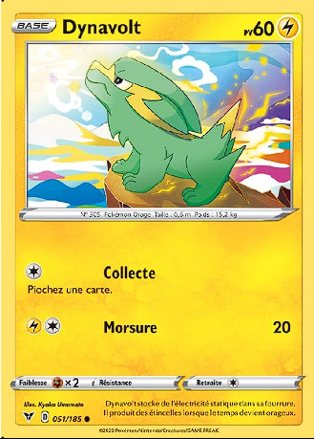
Why should you version an API ?
“Semantic versionning and breaking changes”
API
Frontend APP
evolution_pictures = [base.png, ev1.png…]
/cards
evolution_pictures[evolution_stage]
{
…
‘evolution_stage’: 0,
…
}

Slide 28

Why should you version an API ?
“Semantic versionning and breaking changes"
API – new version
Frontend APP
/cards
“Error trying to parse ‘base’ as int”
{
…
‘evolution_stage’: ‘base|mega|…’
…
}

Slide 29
Why should you version an API ?
“Semantic versionning breaking changes”
API – new version
Frontend APP
/v1/cards
{
…
‘evolution_stage’: 0,
…
}
/v2/cards

Slide 30
How do you version an API ?
“Semantic versionning and breaking changes”
2.4.9
Major version
Minor version
Patch

Slide 31
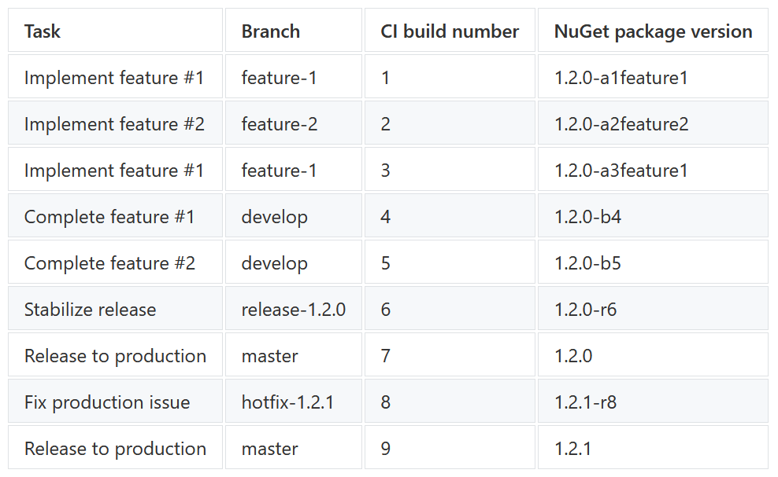
How can API versions be simplified
"Use names that mean something"

Slide 32
EXERCISE : Version an API
https://gitlab.athoria.fr/internal/training/examples/api-training/-/tree/main/versioning_exercise?ref_type=heads

Slide 33


Caching principle
“Save resources and time”
Cache in memory
20ms
Application
1 seconde
Database

Slide 34

The process of caching data
“Save resources and time"
API
Endpoint /stores
[
{
"id": 1,
"nom": "PokeCartes Paris",
"adresse": "123 rue de la République, 75001 Paris",
"telephone": "+33 1 23 45 67 89",
"email": "contact@pokecartesparis.fr"
},
…
db
Users

Slide 35
The process of caching data
"Save resources and time"
API
Endpoint /cards
DB
Users
[
{
"carte": "Pikachu",
"edition": "Première édition",
"condition": "Neuf",
"prix": 20.50,
"quantite": 150
},
…

Slide 36
Advandced HTTP verbs
Act like a GET but only retrieves header
HEAD
Recovering metadata with a reduced payload

Slide 37
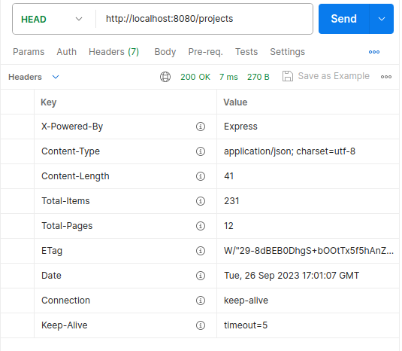
Advandced HTTP verbs
HEAD

Slide 38


Issue
“We've got a CRUD, which is great, but how do we know who can do what ?”
"Delete all"
API interacting with my database
Random user clicking on a "trash" button
Other users looking for their data

Slide 39
Advandced HTTP verbs
Returns the available options for a URI (usable verbs, etc..)
OPTIONS
CORS pre-flight requests

